Slide 1
Why do you need Expressions?
Problem | Solution in Human World | Solution in Computer World
Problem description | Algebraic Equations | Expressions Literals Variables Operators Evaluation Order

Slide 2
Python

Slide 3
Literals & Variables in python
Data in Human World | How do you express in python?
Positive & Negative Whole Numbers | int
Decimal Numbers | float
True or False values | bool
Single character values | str
Character group values | str

Slide 4
Arithmetic Operators in python
Operations in Human World | How do you express in python?
Addition | +
Subtraction | -
Multiplication | *
Division | / or //
Modulus or Remainder | %
Exponent | **

Slide 5
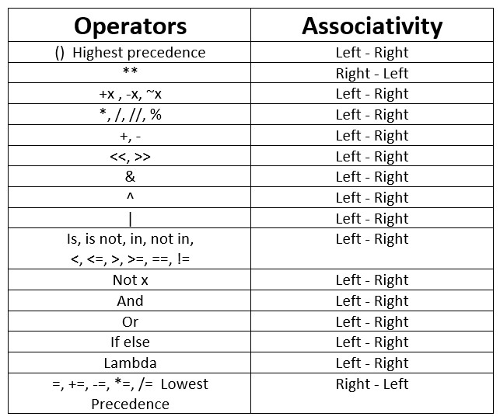
Evaluation of Expression in python
Equation in Human World | Expression in python
x * 2 + y * 3 – z ** 6 | x * 2 + y * 3 – z ** 6

Slide 6
C++

Slide 7
Literals & Variables in c++
Data in Human World | How do you express in c++?
Positive & Negative Whole Numbers | short, int, long, long long(signed/unsigned)
Decimal Numbers | float, double, long double
True or False values | boolean
Single character values | char
Character group values | string

Slide 8
Arithmetic Operators in python
Operations in Human World | How do you express in python?
Addition | +
Subtraction | -
Multiplication | *
Division | /
Modulus or Remainder | %
Exponent | pow()

Slide 9
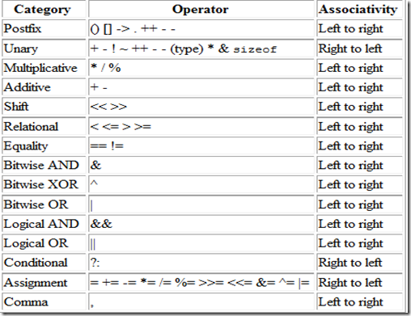
Evaluation of Expression in c++
Equation in Human World | Expression in python
x * 2 + y * 3 – z ** 6 | x * 2 + y * 3 – z ** 6

